Slide 1

NML-WG: Outreach Session
Anand Patil, DANTE
OGF 24, Singapore, 17 Sep 2008

Slide 2

OGF IPR Policies Apply
“I acknowledge that participation in this meeting is subject to the OGF Intellectual Property Policy.”
Intellectual Property Notices Note Well: All statements related to the activities of the OGF and addressed to the OGF are subject to all provisions of Appendix B of GFD-C.1, which grants to the OGF and its participants certain licenses and rights in such statements. Such statements include verbal statements in OGF meetings, as well as written and electronic communications made at any time or place, which are addressed to:
    the OGF plenary session,
    any OGF working group or portion thereof,
    the OGF Board of Directors, the GFSG, or any member thereof on behalf of the OGF,
    the ADCOM, or any member thereof on behalf of the ADCOM,
    any OGF mailing list, including any group list, or any other list functioning under OGF auspices,
    the OGF Editor or the document authoring and review process
Statements made outside of a OGF meeting, mailing list or other function, that are clearly not intended to be input to an OGF activity, group or function, are not subject to these provisions.
Excerpt from Appendix B of GFD-C.1: ”Where the OGF knows of rights, or claimed rights, the OGF secretariat shall attempt to obtain from the claimant of such rights, a written assurance that upon approval by the GFSG of the relevant OGF document(s), any party will be able to obtain the right to implement, use and distribute the technology or works when implementing, using or distributing technology based upon the specific specification(s) under openly specified, reasonable, non-discriminatory terms. The working group or research group proposing the use of the technology with respect to which the proprietary rights are claimed may assist the OGF secretariat in this effort. The results of this procedure shall not affect advancement of document, except that the GFSG may defer approval where a delay may facilitate the obtaining of such assurances. The results will, however, be recorded by the OGF Secretariat, and made available. The GFSG may also direct that a summary of the results be included in any GFD published containing the specification.”
OGF Intellectual Property Policies are adapted from the IETF Intellectual Property Policies that support the Internet Standards Process.
Notes:
IPR Notices Note Well for OGF meetings

Slide 3
Agenda
Introduction
Background
Use Cases
Why NML?
Scope, Deliverables
People Involved
Existing Work (NDL, NMWG, cNIS)
Current Status
Brief explanation of schema
Issues
Future Plans

Slide 4
Introduction
This is an outreach session
  No note takers required !
NML: Network Mark-up Language
A standard schema for exchanging network topology description

Slide 5
Background
Research networks offering new multi-domain services
Exchange network topology information
  Policy
  Provisioning (lightpaths), Pathfinding
  Monitoring, Measurements, Visualisation
  SLA, Trouble Tickets, Asset Management etc
Lack of a common model for description of network
Identified need for a standardized way for exchange network information

Slide 6
Why NML?
NML : An effort to combine various initiatives into a single standard
  University of Amsterdam (NDL)
  OGF Network Measurement WG (NMWG) / perfSONAR
  GÉANT2 (common Network Information Service)
Efforts in GLIF, Internet2, ESNet etc

Slide 7
NML Scope
Define a schema
  as generic as possible
Layer independent model
Common properties across network technologies
Mechanism to incorporate technology specific extensions

Slide 8
Deliverables
Context Document
An informational document providing detailed overview of the framework in which the group operates detailing the existing initiatives and providing the basis for integration
Initial schema
A recommendation document with the initial schemata of NML-WG. It will provide a standardized schema to describe hybrid optical networks
Experiences and Early Implementations
An informational document with results and feedback from the implementations of first NML schema; focus on use cases and applications
Final schema
A recommendation document with the final schema incorporating all the changes and requirements from early experiences and OGF community

Slide 9
Positions
Co-Chairs:
Paola Grosso | University of Amsterdam
Martin Swany | University of Delaware
Authors:
Authors:
Jeroen van der Ham | University of Amsterdam
Bert Andree | University of Amsterdam
Martin Swany | University of Delaware
Jeroen van der Ham | University of Amsterdam
Bert Andree | University of Amsterdam
Martin Swany | University of Delaware

Slide 10
Positions
Reviewers:
Cees De Laat | University of Amsterdam
Paola Grosso | University of Amsterdam
Freek Djikstra | University of Amsterdam
Anand Patil | DANTE
Jerry Sobiesky | MAX
Chris Tracy | MAX
John Volbrecht | Internet2

Slide 11
NDL
Network Description Language
Developed in 2005 to describe computer networks in an interoperable way
Based on the Resource Description Framework (RDF), a Semantic Web technology (www.w3.org/RDF)
Extended in 2007 to multi-layer with technology independent layer descriptions
NDL has demonstrated multi-layer path finding (which may contain loops!)
In use for pathfinding in SURFnet6 (Dutch NREN network)
Currently extending towards other resources to satisfy requests such as: "Find video containing x and transcode to display on tiled-display“
(Slide courtesy NDL team @ UvA)
Notes:
Slide courtesy NDL team @ University of Amsterdam

Slide 12
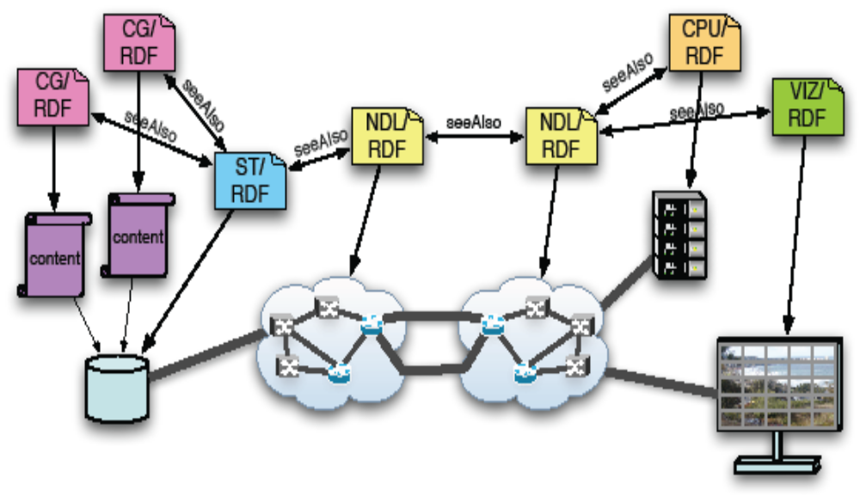
NDL in Action
(Slide courtesy NDL team @ UvA)
Notes:
Slide courtesy NDL team @ University of Amsterdam

Slide 13
cNIS
GÉANT2 cNIS
  Unified repository of network information
  Information about a single domain only
  One self-managed instance of cNIS per domain
RDBMS schema not XML
Technology agnostic core
Plug in architecture for specific technologies
  IP, Ethernet, SDH, OTN
Features
  Topology at different layers
  Time dimension
  Co-relation between layers
  Static and dynamic data
  Automatic data population
  Algorithms (Path Finding, Topology Partitioning and Pruning)

Slide 14
cNIS
cNIS v1.0 (Sep 2007); v1.5 (Sep 2008)
Automated network discovery (IP only)
L2 auto-discovery in progress
Advanced visualisation of database contents
Integrate with AAI framwork - eduGAIN (GIdP), Lookup and Monitoring services
Finalise MPLS, Ethernet, SDH, OTN schema
Automated discovery for Ethernet and SDH

Slide 15
NMWG (nmtopo)
Topology schema developed for perfSONAR
Use namespaces to differentiate between entities e.g. ethernet/port and TCP/port
Recent revisions to the document and schema
  https://anonsvn.internet2.edu/svn/nmwg/doc/nm-topo
In use by DICE IDC
In use by parts of perfSONAR
Feeding into NML-WG work
Notes:
Slide courtesy Martin Swany @ University of Delaware

Slide 16
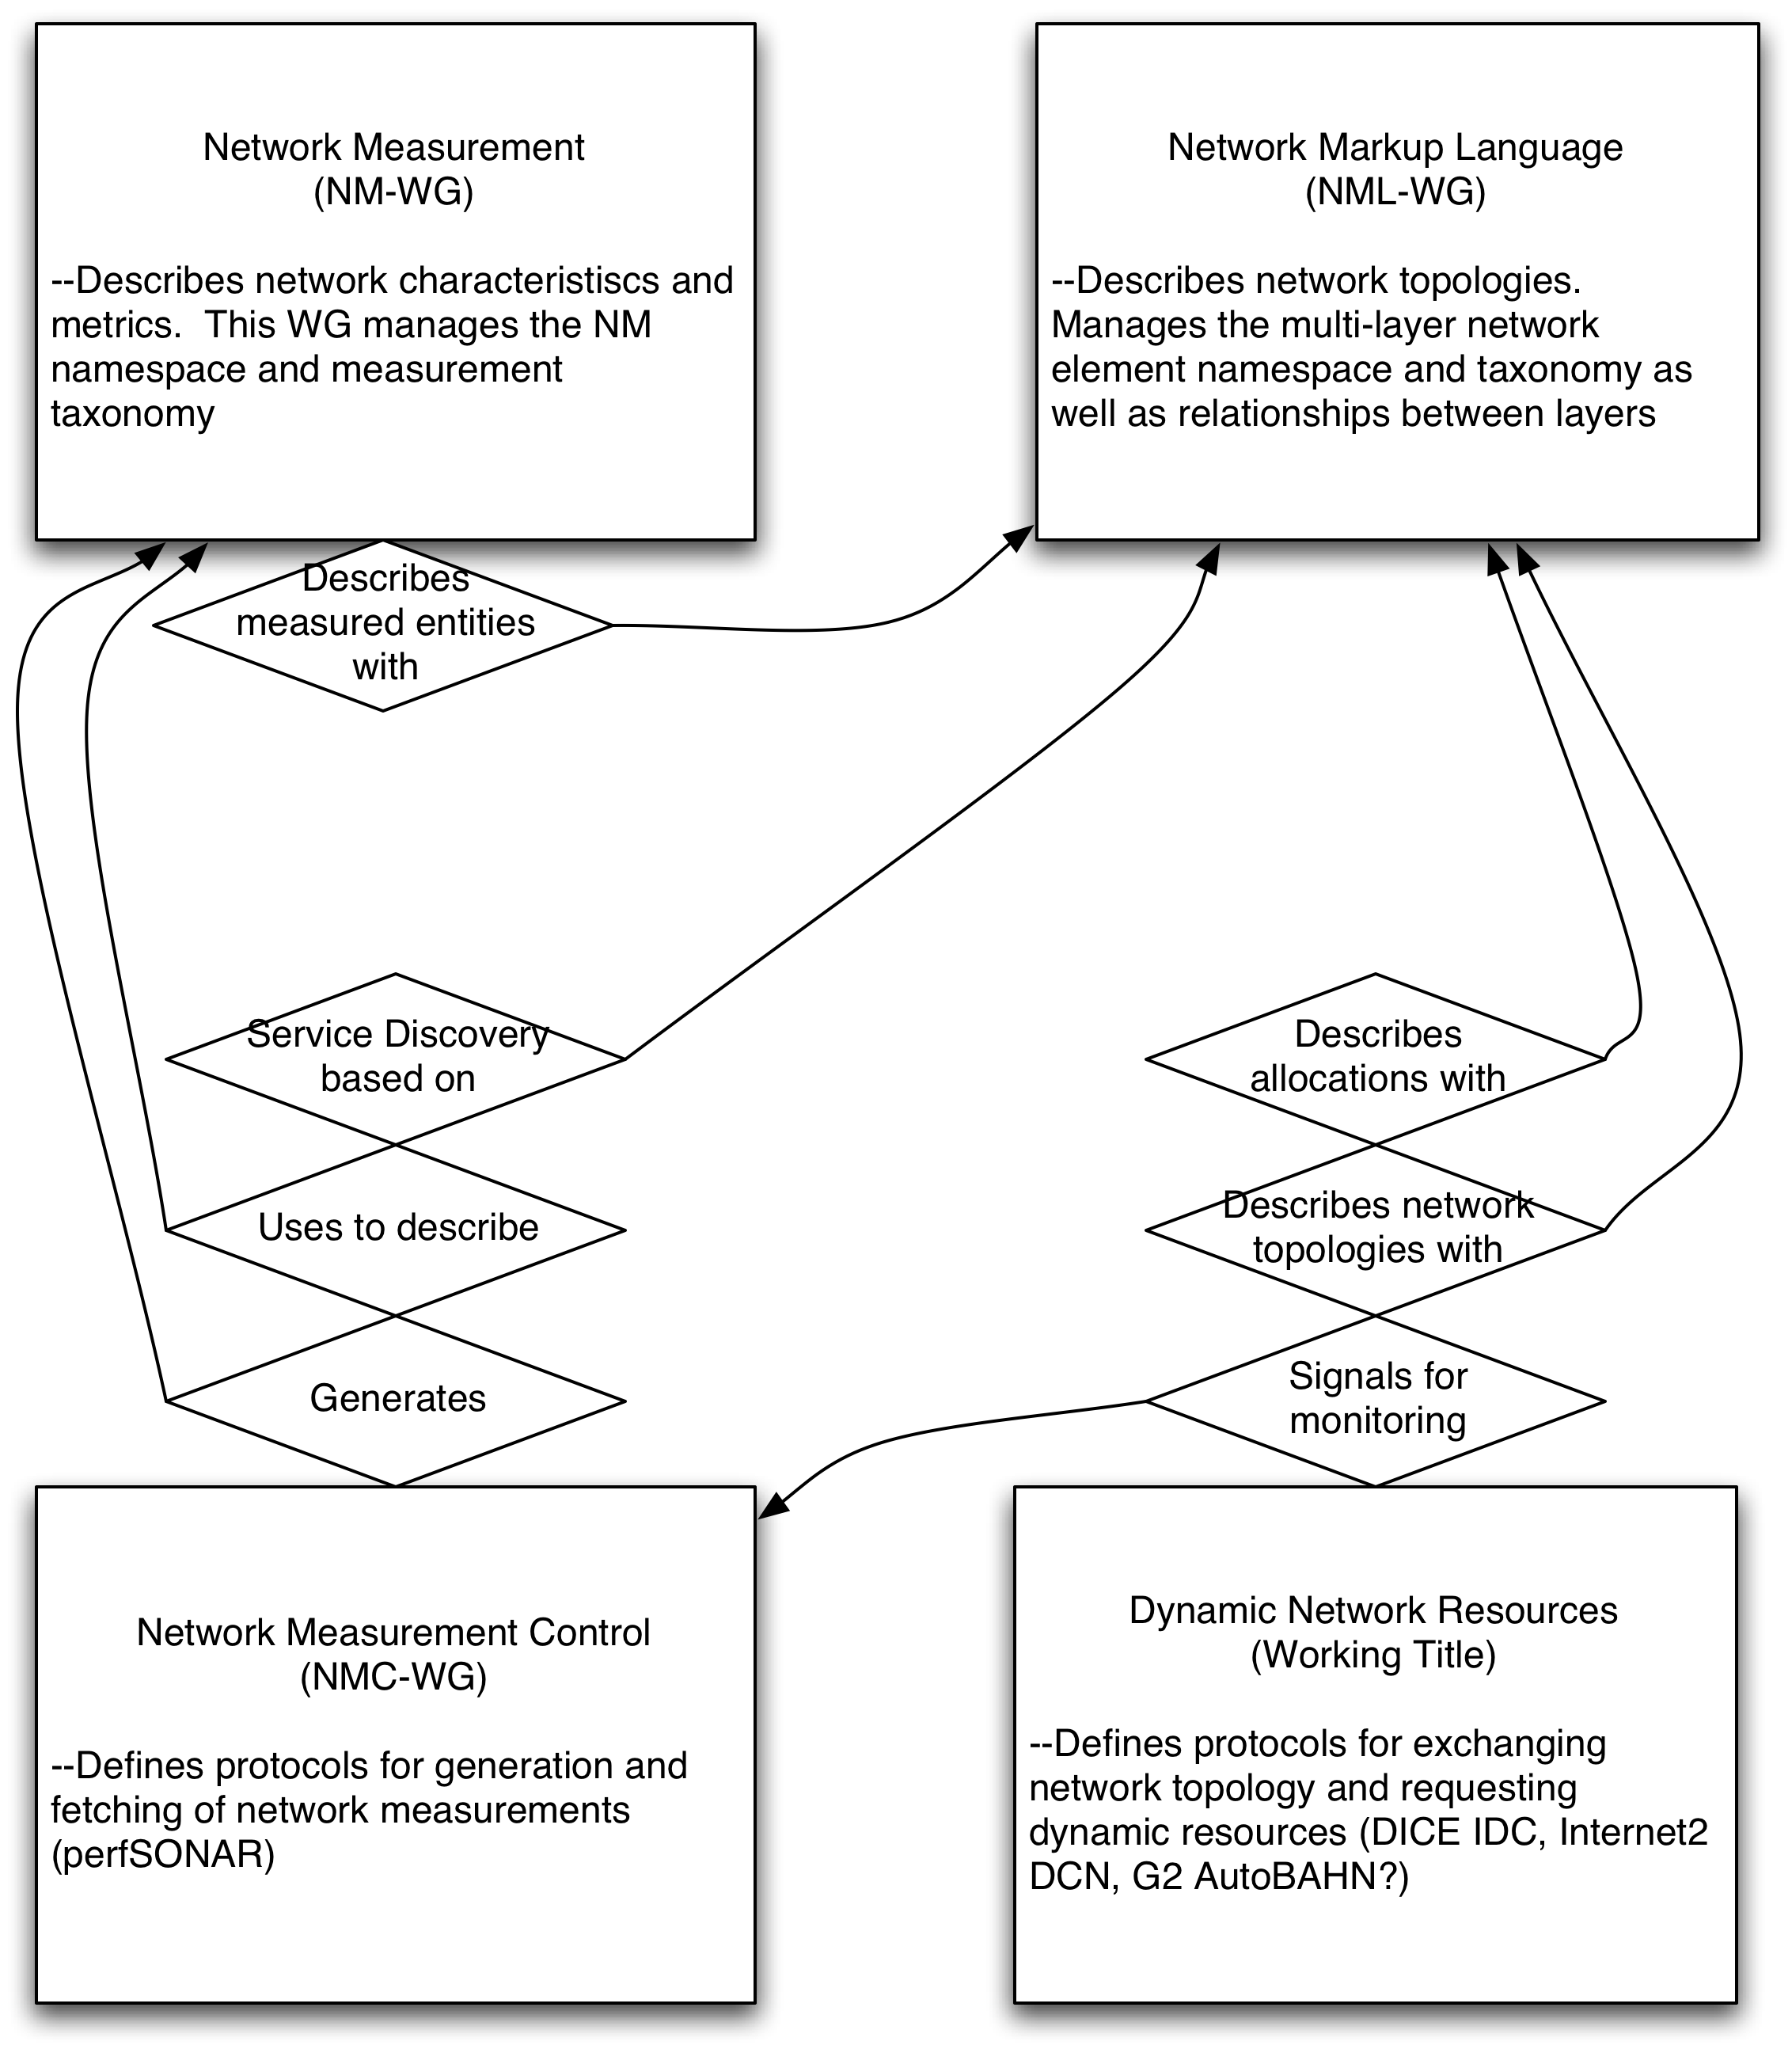
Relationship with other WGs
Network Services Interface
(NSI-WG)
(Slide courtesy Martin Swany @ University of Delaware)
Notes:
Slide courtesy Martin Swany @ University of Delaware

Slide 17
NML Status
Deliverable 1, the Context for the WG work, is in revision by Martin Swany
Several meetings have taken place in since OGF21 in Seattle
Face to face meetings at other events
Deliverable 2, Basic schema is work in progress
  Available on wiki

Slide 18
Core Schema Elements
Network Element (abstract)
Node / Device
Port / Interface
Uni-directional Link
Service
Location
Adaptation

Slide 19
Group Schema Elements
Concept of ‘group’ of basic elements
  Domain
  Bi-directional Link
  Path
  Topology
Abstract grouping allows complex concepts to be represented

Slide 20
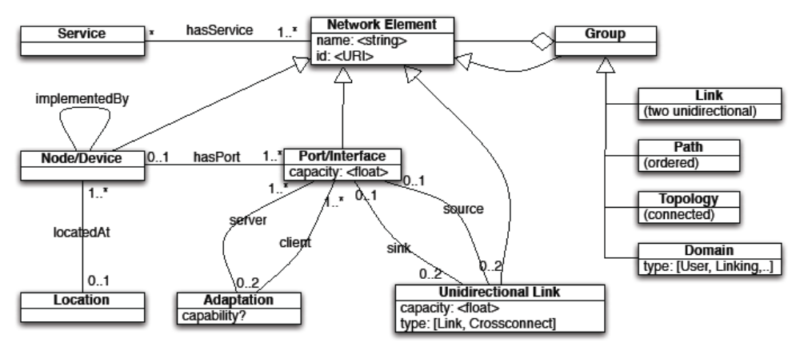
Draft Schema

Slide 21
Issues
Core elements & relationships
Semantics
Addressing
Physical v/s Logical
Point to multi-point to multi-point connections
RDF or XML

Slide 22
RDF or XML Schema
Debate over using RDF versus XML
Model versus Syntax
Graph versus Tree
Current Approach
  Core data model in UML
  a schema for the RDF (OWL?)
  a schema for the XML (RELAX NG?)
  a mapping/translation between the two
Notes:
Main advantage of RDF over basic XML is its simplicity
RDF data model is a graph. XML Schema data model is a tree.

Slide 23
Future Plans
Request for URN urn:ogf:network
Submit the first deliverable ASAP
Submit second deliverable in next few months
Validation against existing use cases
Translation into NDL, XML
cNIS to implement NML schema
Refine data model towards final deliverable

Slide 24
Further Information
Project Gridforge Site
  http://forge.ogf.org/sf/projects/nml-wg
Mailing list
  nml-wg@ogf.org
Please contact the co-chairs to join/subscribe

Slide 25
Open Discussion
Questions?
Comments
Feedback

Slide 26
Thank You
Any further Questions, Comments, Feedback or Suggestions please contact
Anand Patil
anand.patil@dante.org.uk

Slide 27
Full Copyright Notice
Copyright (C) Open Grid Forum (2008). All Rights Reserved.
This document and translations of it may be copied and furnished to others, and derivative works that comment on or otherwise explain it or assist in its implementation may be prepared, copied, published and distributed, in whole or in part, without restriction of any kind, provided that the above copyright notice and this paragraph are included on all such copies and derivative works.
The limited permissions granted above are perpetual and will not be revoked by the OGF or its successors or assignees.
Notes:
OGF Full Copyright Notice if necessary

